Slide 1
Group assignment
Group “Empty”
Member: Yue Zheng, Zeran wang, Tianyi Mao, Dehong Xiao

Slide 2
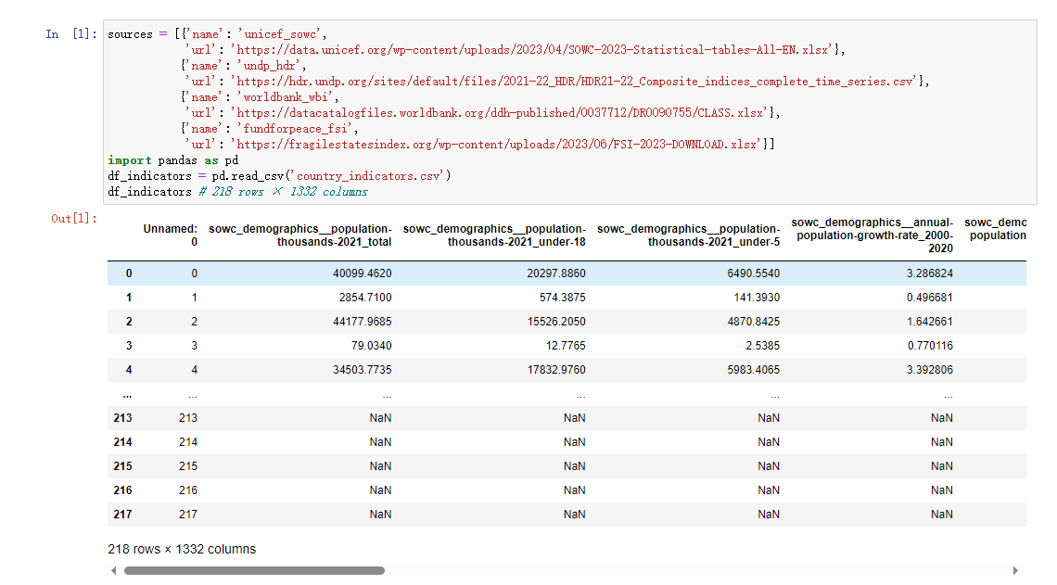
Input the original file ”country_indicators.csv”

Slide 3
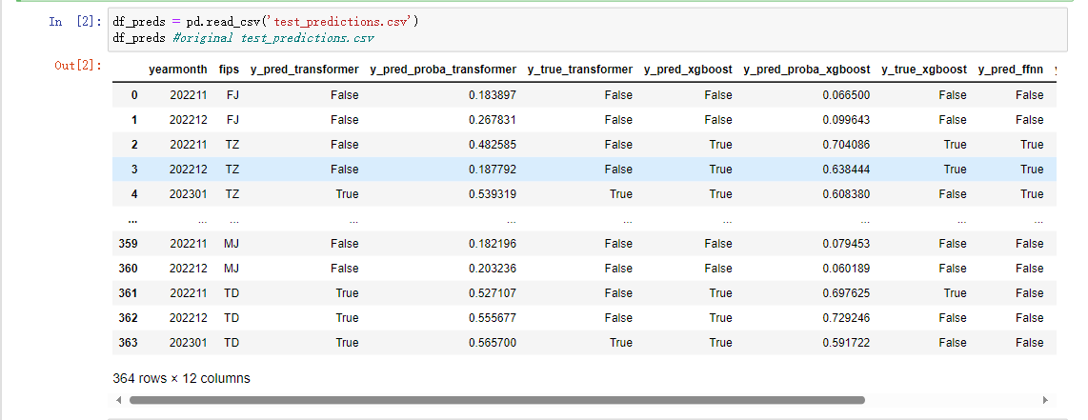
Input the original file ” test_predictions.csv”

Slide 4
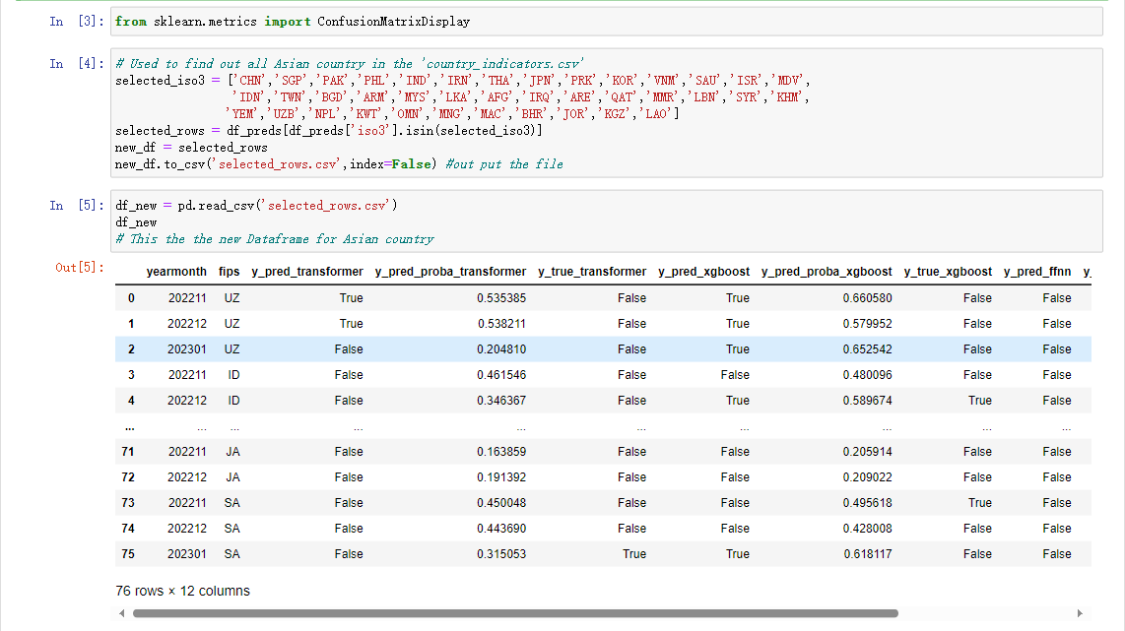
Selecting the country we want

Slide 5
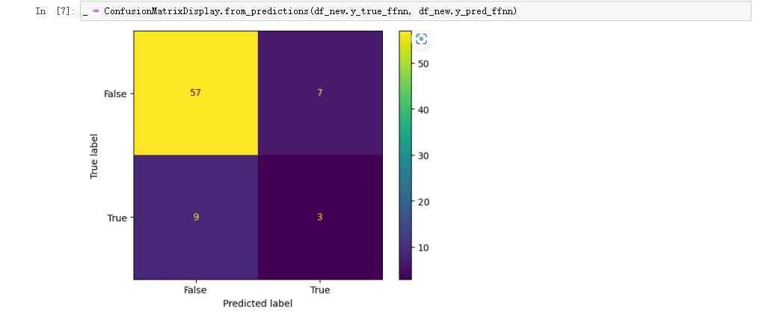
The graph with default value

Slide 6
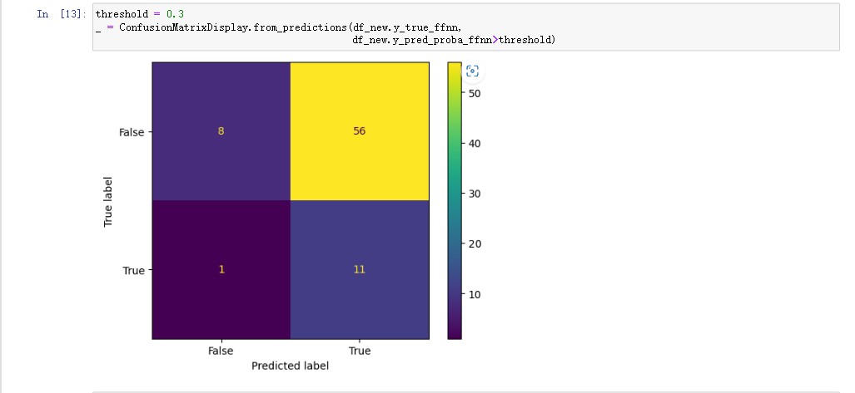
The graph with threshold = 0.3

Slide 7
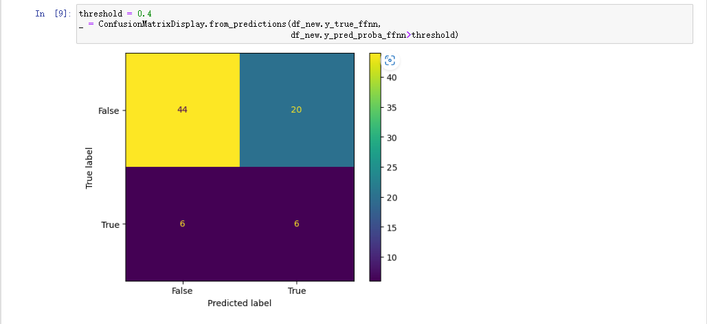
The graph with threshold = 0.4

Slide 8
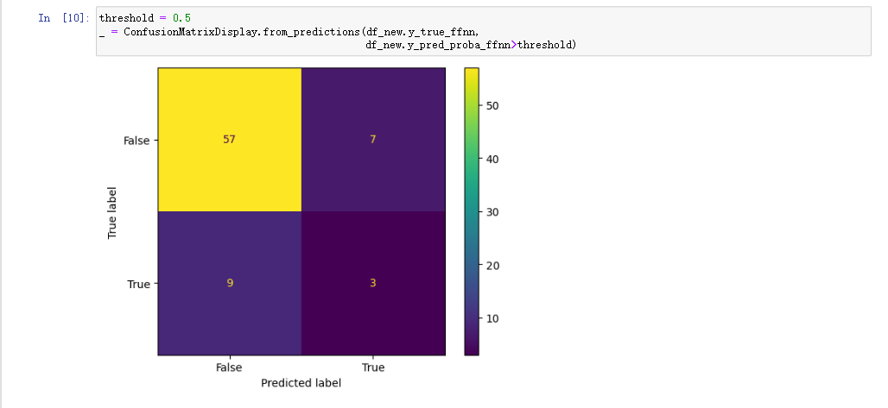
The graph with threshold = 0.5

Slide 9
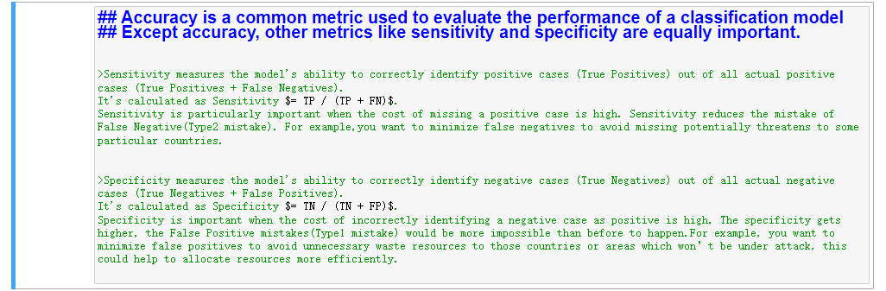
The data analysis for Three concepts

Slide 10
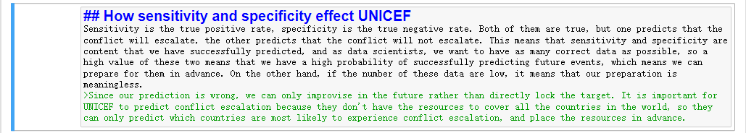
How these influence UNICEF

Slide 11
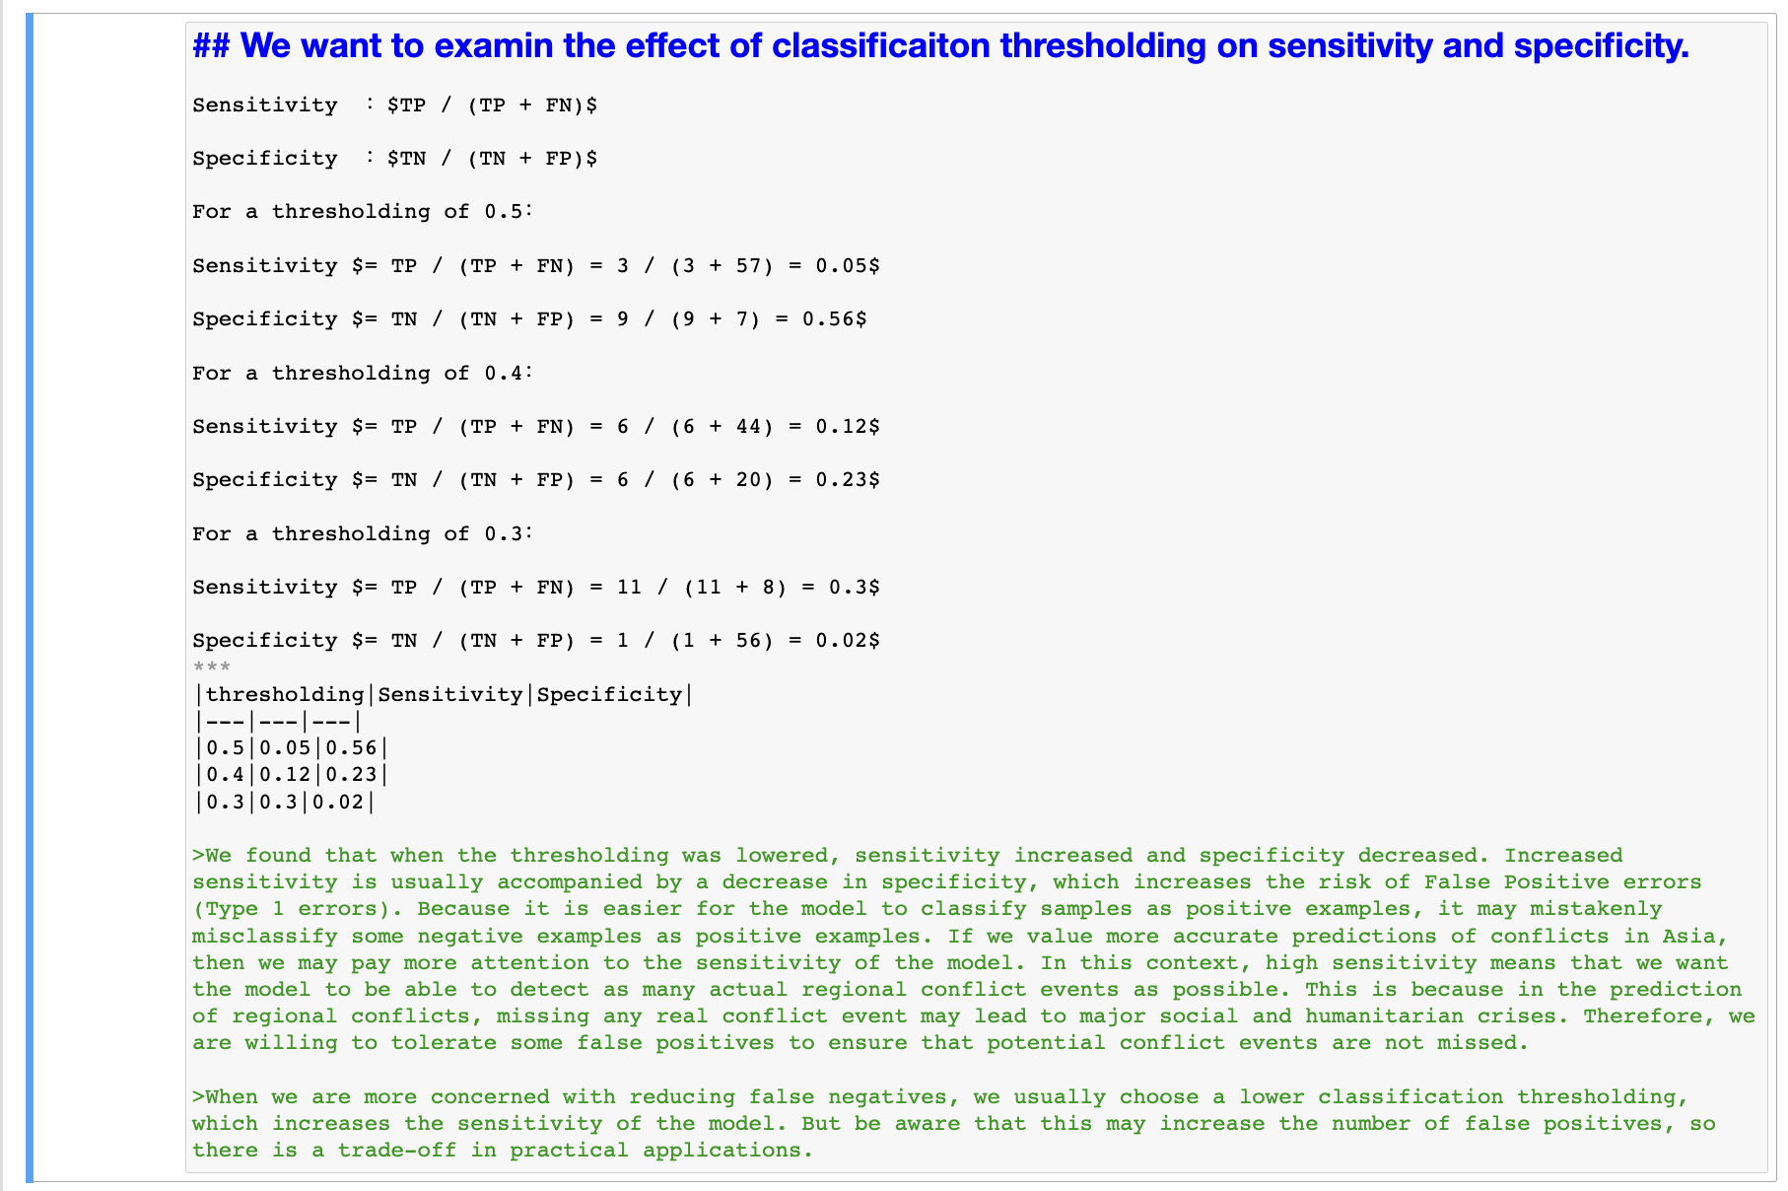
The effect of threshold

Slide 12
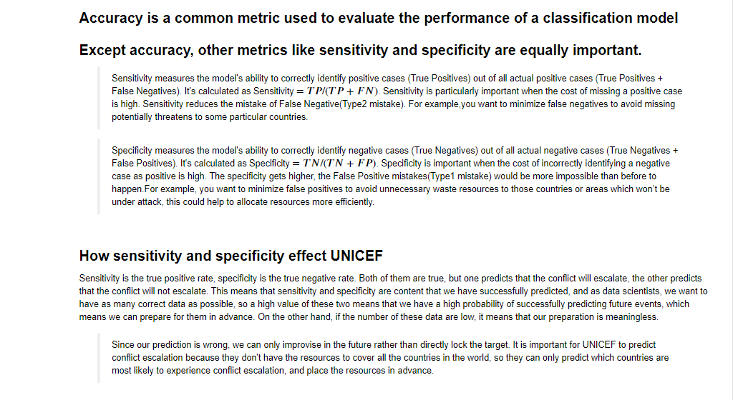
The final expression of analysis:

Slide 13
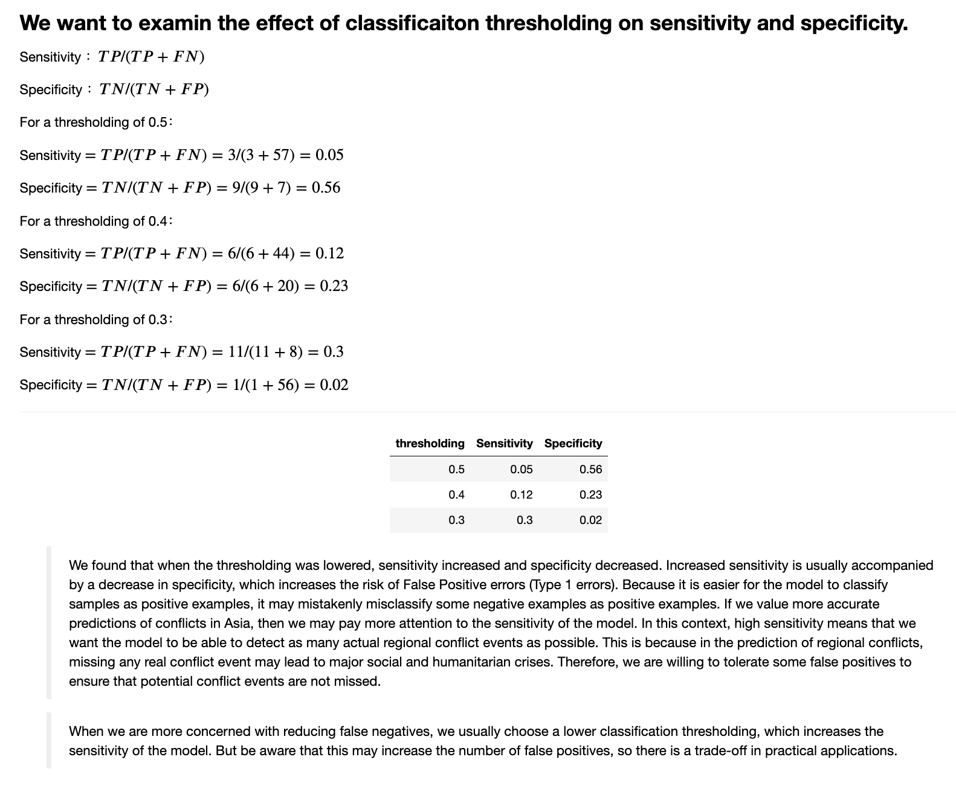
The final expression of analysis:

Slide 14
Project 2

Slide 15
The analysis of three models
The following contents will totally describe the difference about the predicted results
Detail statistic proof will be showed numerically
We carry on with our work through two methods:
1: under one same sample, calculate the result by three models
2: use one exact model to calculate the result by different samples

Slide 16
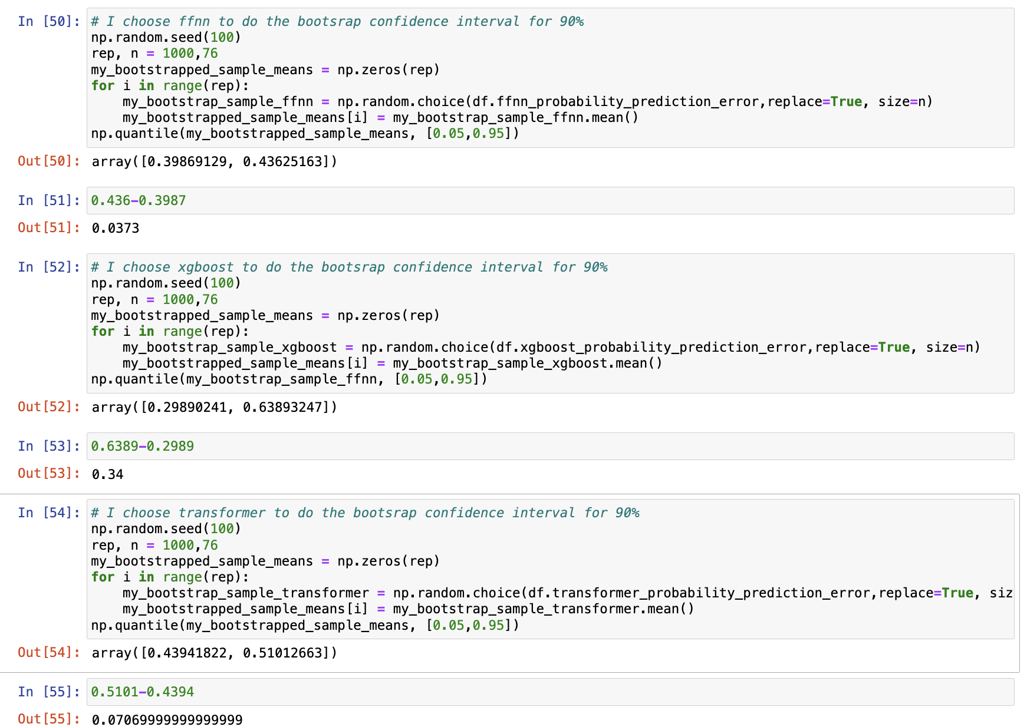

Slide 17
Analysis of method 1
When we compare the confidence intervals of probability prediction error of three different models ffnn, xgboost and transformer. We can find that with the same 90% confidence interval, the ffnn model has a range from 0.3987 to 0.436, the xgboost model has a range from 0.2989 to 0.6389, and the transformer model has a range from 0.4394 to 0.5101.
Among them, the range length of the ffnn model is approximately 0.0373, the range length of the xgboost model is approximately 0.34, and the range length of the transformer model is approximately 0.070.
In contrast, we can see that for the same 90% confidence interval, our preferred model is ffnn, because it gives us a more accurate true value.
However, the transformer model does not have a very big difference from the ffnn model, so it can also be included in our choice. But the xgboost model offers too much scope, which means it is the last option.
When we increase the number of repetitions we find that the confidence intervals for the three models still correspond to this order, the range of ffnn is smaller than the transformer and they are very similar, while the range provided by xgboost is much larger.
The general method is bootstrap

Slide 18
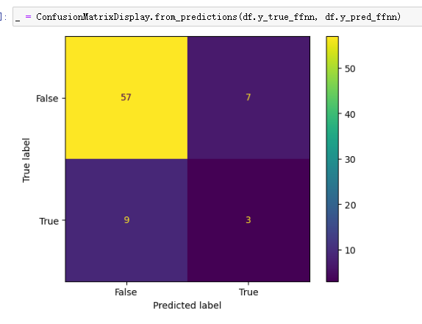
Visible table

Slide 19
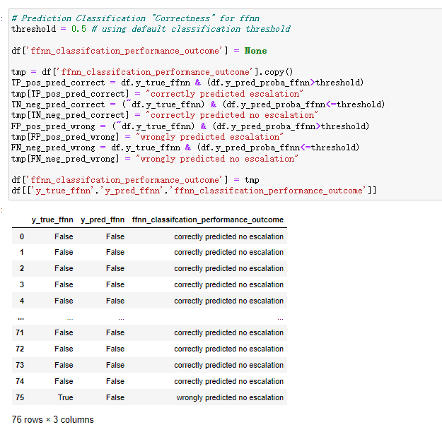
One sample, different model
Code of “ffnn”

Slide 20
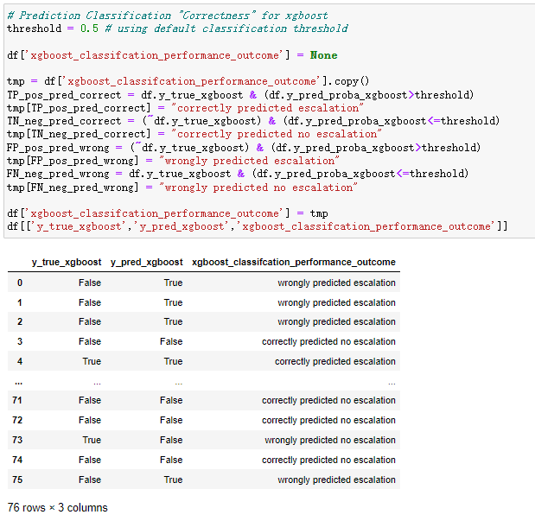
Use “xgboost”

Slide 21
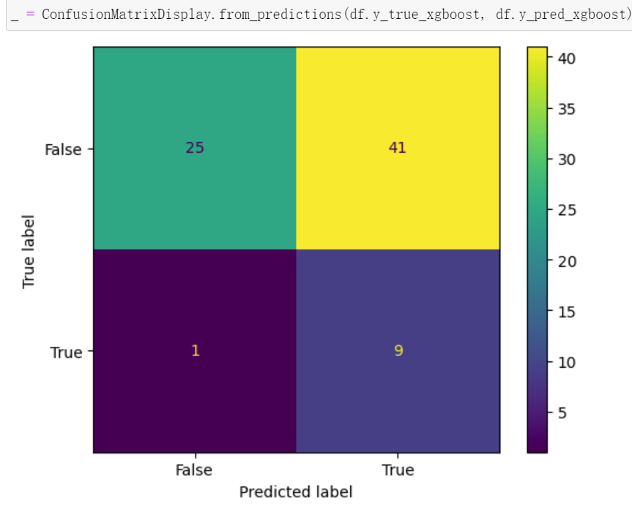
Visible table

Slide 22
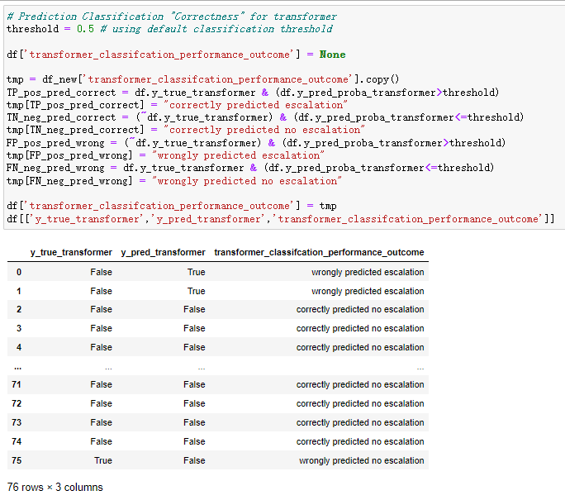
Use “transformer”

Slide 23
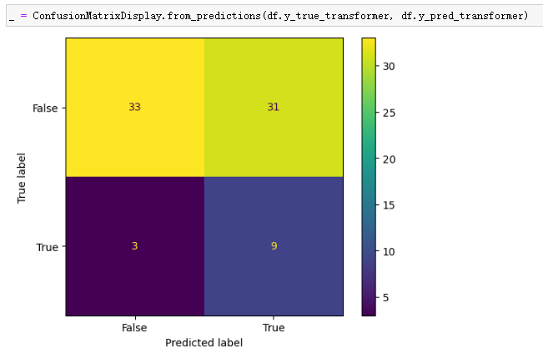
Visible table

Slide 24
One model, different samples
Next, we will introduce the comparison of the results obtained by three different models under different data samples.

Slide 25

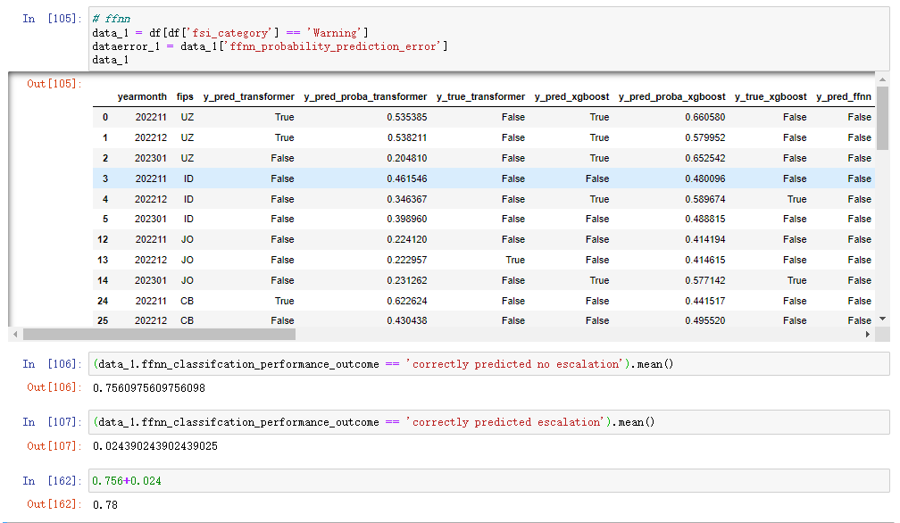
Use ffnn
For sample ‘fsi_category’ == ‘Warning’

Slide 26
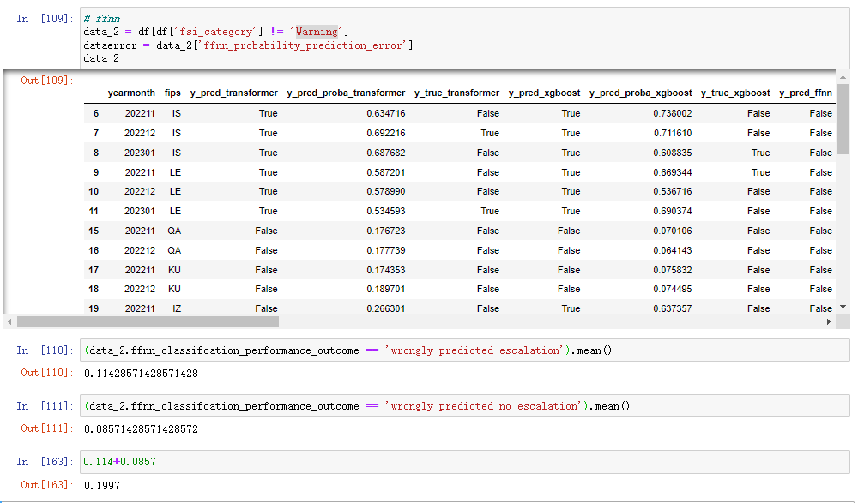
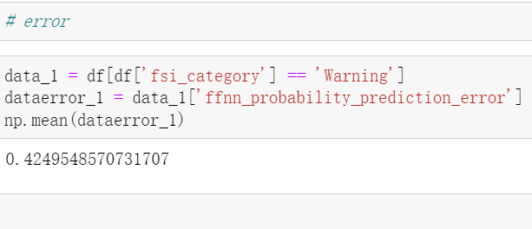
Use ffnn
For the sample ‘fsi_category’ != ‘Warning’

Slide 27
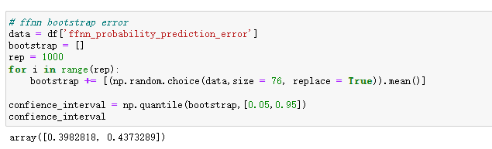
FFnn bootstrap error

Slide 28
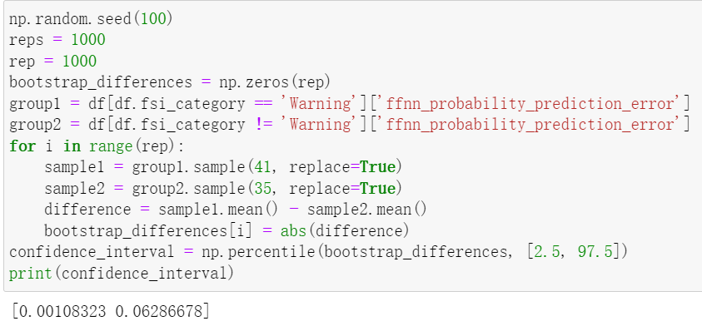
Two groups

Slide 29
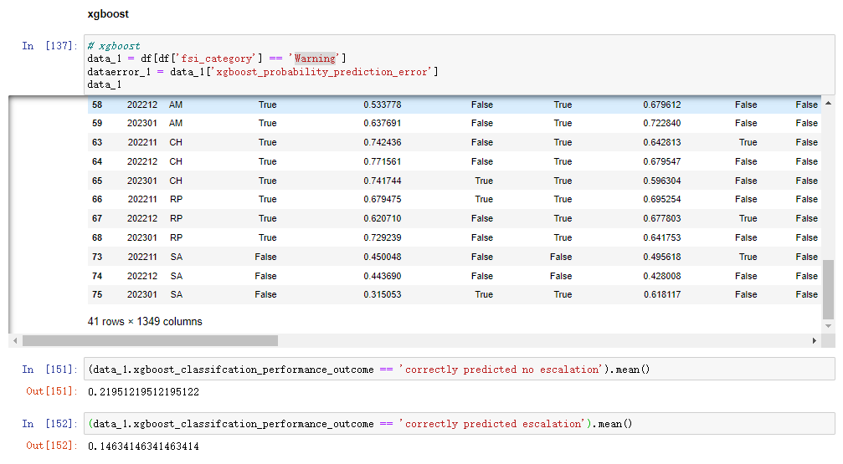
Use xgboost
For the sample ‘fsi_category’ == ‘Warning’

Slide 30
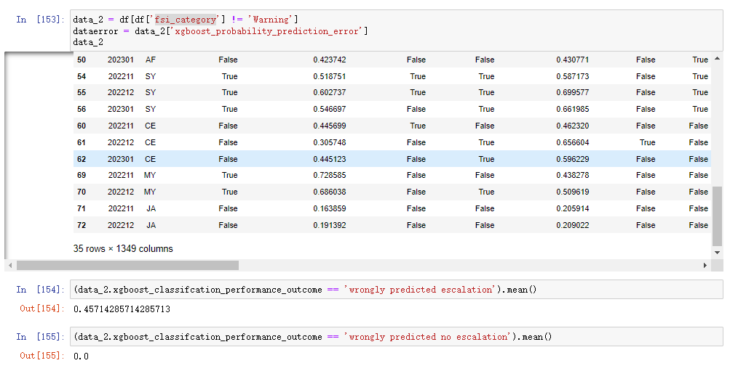
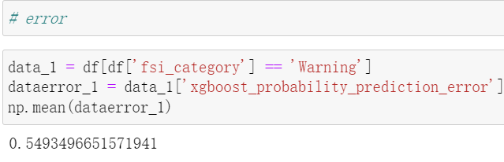
Use xgboost
For the sample ‘fsi_category’ != ‘Warning’

Slide 31
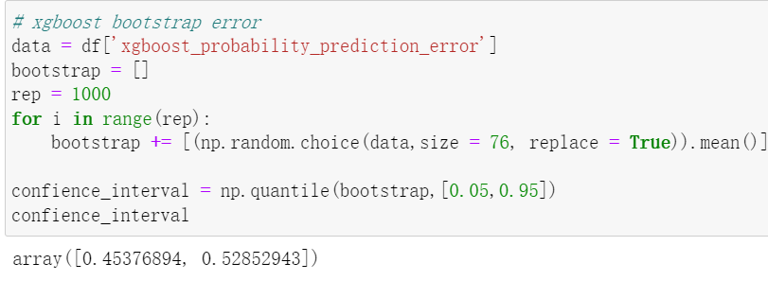
Xgboost bootstrap error

Slide 32
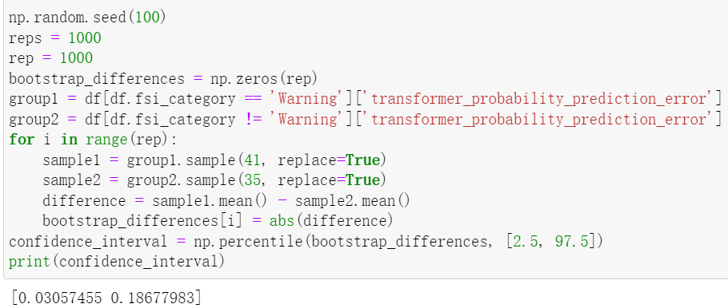
Two groups

Slide 33
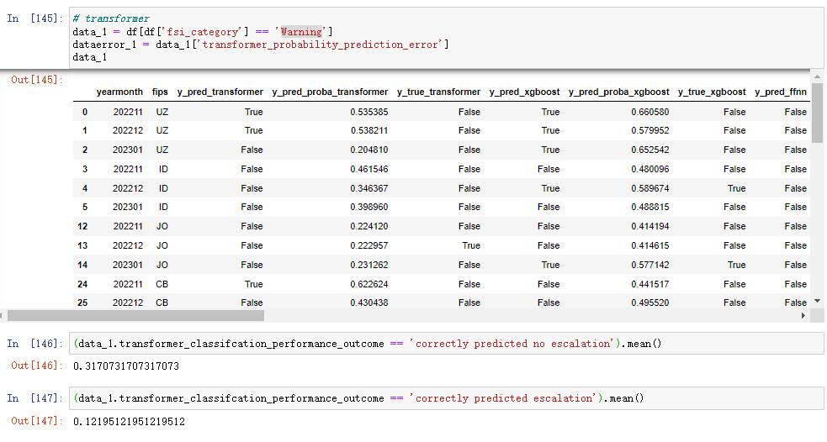
Use transformer
For the sample ‘fsi_category’ == ‘Warning’

Slide 34
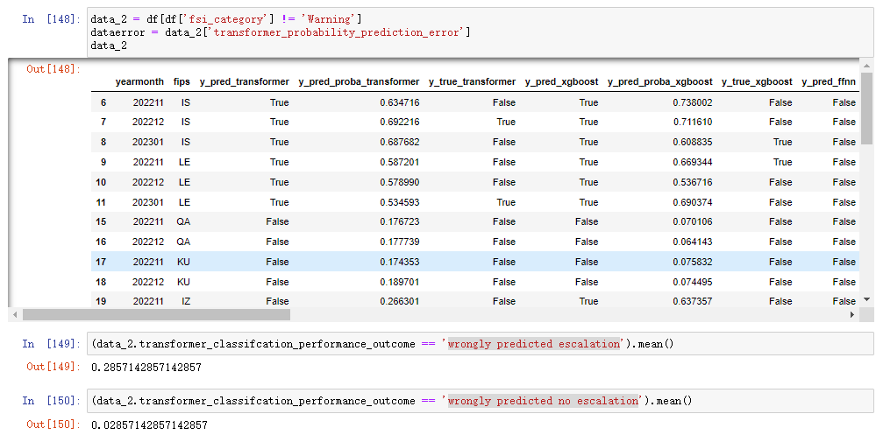
Use transformer
For the sample ‘fsi_category’ ！= ‘Warning’

Slide 35
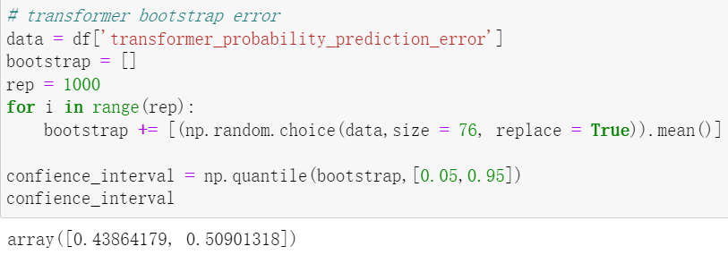
Transformer bootstrap error

Slide 36
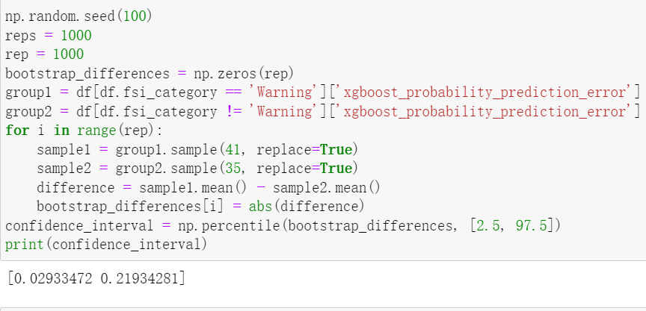
Two groups

Slide 37
Analysis of method2
1. FFNN Model Analysis:
In data where the 'fsi_category' is 'Warning', the FFNN model had a higher rate of "correctly predicting no escalation" at 75.6% compared to "correctly predicting escalation" at 2.4%. This suggests the model is better at predicting scenarios with no escalation in 'Warning' categories. Conversely, for cases not categorized as 'Warning', the rate of "wrongly predicting escalation" was 11.4%, and "wrongly predicting no escalation" was 8.5%. This indicates a higher tendency for the model to incorrectly predict escalation in non-'Warning' scenarios.
2. xgboost Model Analysis:
In the 'Warning' category, "correctly predicting no escalation" was at 21.95%, significantly higher than "correctly predicting escalation" at 14.6%. This shows the model performs better in predicting no escalation in Warning contexts. For non-'Warning' categories, the accuracy drops with "correctly predicting no escalation" at 45.7% and "correctly predicting escalation" at 0%. This reflects a reduced accuracy in non-Warning countries.

Slide 38
Analysis of method2
3. Transformer Model Analysis:
Within the 'Warning' lending category, the model had a "correctly predicting no escalation" rate of 31.7% versus "correctly predicting escalation" at 12.2%. In the non-'Warning' category, "wrongly predicting escalation" was at 28.57%, and "wrongly predicting no escalation" at 2.86%. This indicates a higher likelihood of incorrectly predicting escalation in the non-'Warning' category.

Slide 39
Conclusion
FFNN: Tends to better predict no escalation in 'Warning' scenarios but is more prone to incorrectly predicting escalation in non-'Warning' contexts.
XGBoost: Shows better performance in Warning countries, especially in predicting no escalation, but its accuracy diminishes in non-Warning countries.
Transformer: More balanced in the 'Warning' category, but in non-'Warning' categories, it tends to incorrectly predict escalation.

Slide 40
Bootstrap sampling in method 2
We analyzed the performance of three models (FFNN, Transformer, XGBoost) across different 'fsi_category' groups ('Warning' and non-'Warning') using bootstrap sampling. Our goal was to compare the prediction error differences between these categories for each model. For the FFNN model, we found that the prediction error remains relatively consistent across different 'fsi_category' groups. The 95% confidence interval for error differences was [0.00108, 0.06287], indicating minimal variation. This consistency suggests that the FFNN model maintains a similar level of accuracy irrespective of the category, demonstrating stable performance across varying scenarios.

Slide 41
Bootstrap sampling in method 2
On the other hand, the Transformer and XGBoost models exhibited more significant differences in prediction errors between the two categories. The Transformer model had a wider 95% confidence interval of [0.03057, 0.18678], and XGBoost even wider at [0.02933, 0.21934], suggesting that their performance is more dependent on the specific category.

Slide 42
In summary of method 2
If our aim is to find a model with stable performance across different 'fsi_category' scenarios, the FFNN model appears to be a better choice. Its prediction accuracy does not fluctuate much between different categories. However, if the focus is on a specific category, such as 'Warning' or non-'Warning', further exploration of the Transformer or xgboost models would be beneficial, as they may offer better accuracy in particular contexts.

